Slide 1
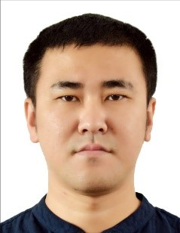
Yang Shao Peng, Lead Engineer, Wuxi
Photo
Education
2007-2011: Bachelor in Electronics and Information Engineering, Jiangnan University
2011-2014: Master in Electronics and Communication Engineering, Jiangnan University
Working Experience
2011-2012 Internship as Hardware Engineer @ Wuxi Gallop Technology, Smart Grid Monitoring
2014-2018 Sr. Software Engineer @ Finisar Corp., Test Software Development & Data Analysis
2018-2021 Sr. Software Engineer and Team Leader @ Bosch China, I4.0, IIoT & Connectivity
2021- Lead Engineer @ Siemens Ltd. China, Connectivity & Edge application development
Personal interests and career expectations （including mobility）
Personal interests Learn and practice new things both for work and life, better understand how the world is running.
Career expectations Provide maximum output from myself to organization, gain maximum input from organization to myself.
Mobility Has been to Germany, US, Ukraine and Russia several times. Engaged in oversea teams in most career so far. Highly motivate to further travel international.

Slide 2
Yang Shao Peng, Lead Engineer, Wuxi
Key Expertise
Web and client application development(8 years experience)
Proficient in both backend and frontend development for web and client applications, using multiple programming languages and frameworks.
Data Analysis and Modeling (8 years experience)
Proficient in sensor and industrial related data collection, storage, analysis, visualization and modeling, including both statistical and machine learning approach.
Software Engineering and Project Management(4 years experience)
Good at software definition and execution, especially Agile projects.
Main project experience summary
Prior to joining Siemens:
2014-2018: Test Software Development and Quality Management using 6-sigma
2018-2020: MOVE – Sino-German public funded I4.0 project
2020-2021: Bosch and UAES Internet of Vehicle solution
2021.6 - 2021.12:
Responsible for Bridge-Monitoring use case within CCS Wuxi project
2021.6 - Present:
Core member of “Device as a Service” team
Condition monitoring and closed loop maintenance solution for automotive assembly (cooperation with FA SO)
Proposal preparation for quality inspection of X-ray tubes (SXVT)
2022.4 - Present:
Project Manager for T CED “Loose Coupling” project
Cross-TF input collection
Coordination of technical work streams in CED DCO and INW

